Slide 1
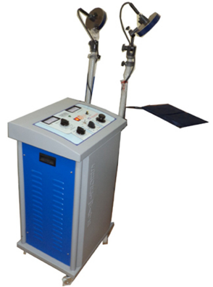
Short-wave diathermy machine
principles of operation
function
use
scientific principles
construction
components
system diagram
inputs/outputs
troubleshooting
identifying common faults
replacing components
rectifying faults
18.4.5 Maintain a short-wave diathermy machine
Unit C18.4 Maintaining Physiotherapy Equipment
Module 279 19 C Medical Instrumentation II
©
dr. Chris R. Mol, BME, NORTEC, 2015

Slide 2
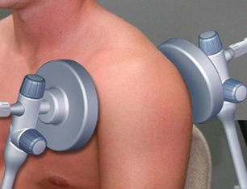
Diathermy (general)
Diathermy literally means "heating through.” Diathermy is the controlled production of "deep heating" beneath the skin in:
subcutaneous tissues (‘under the skin’)
deep muscles
joints
for therapeutic / revalidation purposes.
The application of moderate heat by diathermy increases blood flow and speeds up metabolism and the rate of ion diffusion across cellular membranes.
The fibrous tissues in tendons, joint capsules, and scars are more easily stretched when subjected to heat, thus facilitating the relief of stiffness of joints and promoting relaxation of the muscles and decrease of muscle spasms.
The three main forms of diathermy employed by physical therapists are:
ultrasound
short wave
microwave
©
Short-wave diathermy machine
dr. Chris R. Mol, BME, NORTEC, 2015

Slide 3
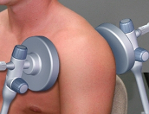
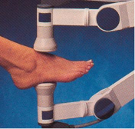
Techniques for Diathermy
Roughly, all 3 different diathermy techniques are used for the same therapeutic purpose.
1. ultrasonic diathermy
= therapeutic ultrasound; see previous lectures
A diathermy device increases tissue temperature by up to 8º C at a depth of
5 centimetres in less than 20 minutes. Hyperthermia is safe if the temperature is kept under 45 °C
2. Short wave diathermy is performed with the use of high-frequency (1–100 MHz) electromagnetic currents.
It is the same technique as used during surgery in an electro-surgical machine, but the heat is spread out over a larger area with a much lower energy density.
3. microwave diathermy
microwaves are electromagnetic waves with a frequency in the 915 MHz or 2.45 GHz bands. Microwaves have a lower penetration depth and are used for more superficial tissues.
When diathermy equipment is utilized, the power output is maintained below the pain threshold of the patient.
©
Short-wave diathermy machine
dr. Chris R. Mol, BME, NORTEC, 2015

Slide 4
Electromagnetic Radiation Spectrum
©
Short-wave diathermy machine
dr. Chris R. Mol, BME, NORTEC, 2015

Slide 5
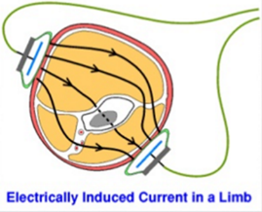
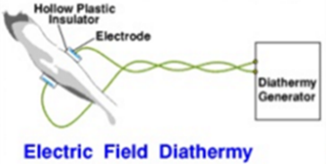
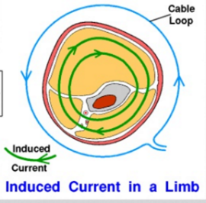
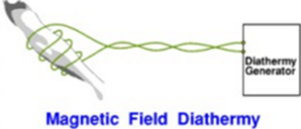
Short wave diathermy
Short wave diathermy is performed with the use of high-frequency electromagnetic currents, usually at 27.12 MHz
Short wave diathermy machines use two condenser plates that are placed on either side of the body part to be treated.
Alternatively, these devices use induction coils that are pliable and can be molded to fit the part of the body under treatment.
The degree of heat and the depth of penetration depend in part on the properties of the tissues that the waves encounter.
©
Short-wave diathermy machine
dr. Chris R. Mol, BME, NORTEC, 2015

Slide 6
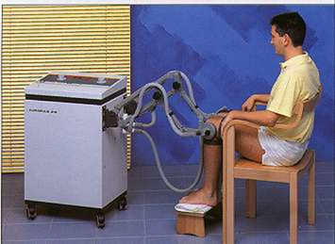
Treatment Procedure
1. Prepare the patient:
Examine thermal and pain sensitivity of the patient
Ensure removal of any metal objects (rings, etc.)
Remove all bandages and clothes from the treatment area
Ensure dryness of skin
Ask to patient to report immediately any abnormal sensation felt during the treatment
2. Prepare the machine:
Ensure correct connection of cables.
Ensure that cables & applicators are not placed on metal surfaces.
Ensure appropriate alignment of the electrodes for maximum energy transfer.
Ensure that cables are not close to untreated tissues.
All metal objects are kept at least 3meters away.
3. Once the unit is activated:
Remain at least 1m from the cables .
Ensure that the patient maintains correct position .
Do not leave the patient alone during treatment.
Ensure the patient does not touch the machine.
Ensure that no other person is in the vicinity of the machine.
Two electrodes are positioned near the target area
©
Short-wave diathermy machine
dr. Chris R. Mol, BME, NORTEC, 2015

Slide 7
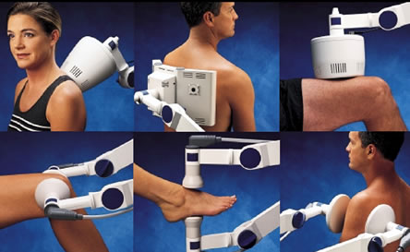
Treatment Procedure
Diathermy uses either continuous or pulsed currents with a pulse rate of 10-400 Hz.
With pulsed currents, the patient receives a lower dose if compared with continuous Diathermy applied during the same time. The tissues will receive lower thermal load.
Typically up to 100 Watt average power; 200 Watt peak power.
Treatment time is 1-30 minutes
©
Short-wave diathermy machine
dr. Chris R. Mol, BME, NORTEC, 2015

Slide 8
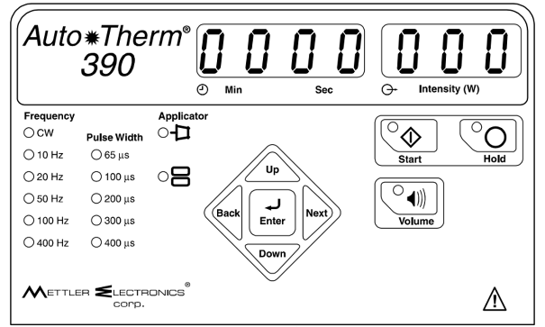
Control Panels
Intensity is a combination of pulse width and pulse frequency…
Tuning can be either manual or automatic
©
Short-wave diathermy machine
dr. Chris R. Mol, BME, NORTEC, 2015

Slide 9
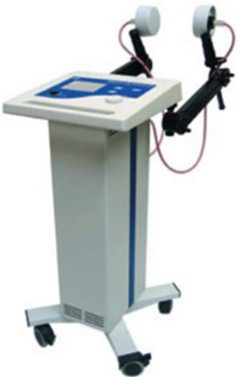
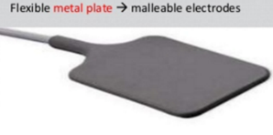
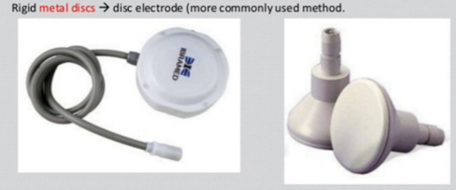
Components
©
Short-wave diathermy machine
dr. Chris R. Mol, BME, NORTEC, 2015

Slide 10
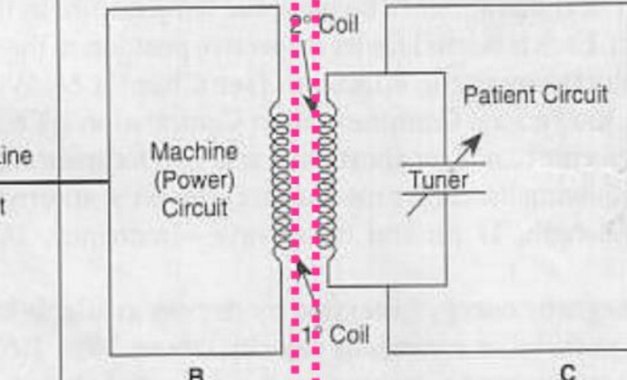
System Diagram Shortwave diathermy unit
The tuner is used to adapt the frequency of the generator to the electrodes resonance frequency
©
Short-wave diathermy machine
dr. Chris R. Mol, BME, NORTEC, 2015

Slide 11
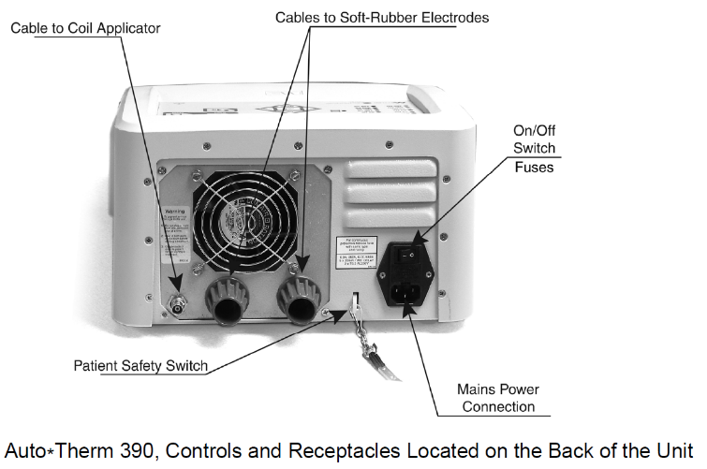
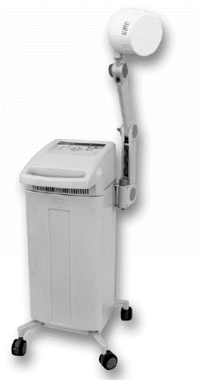
Construction
with optional cart
Example only
©
Short-wave diathermy machine
dr. Chris R. Mol, BME, NORTEC, 2015

Slide 12
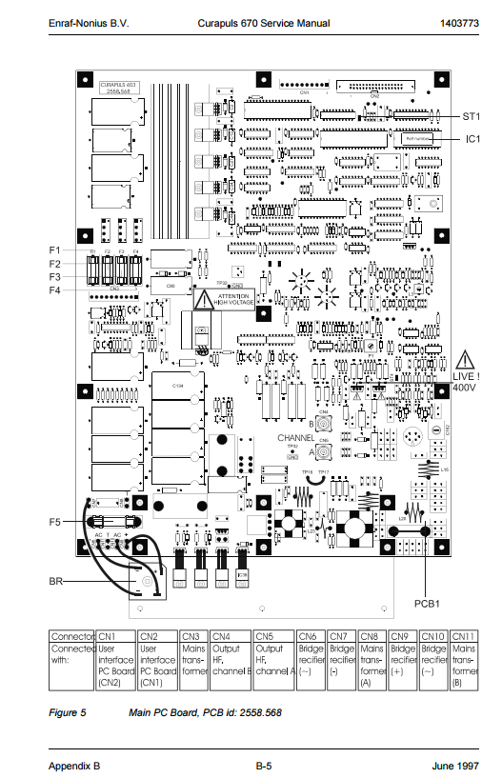
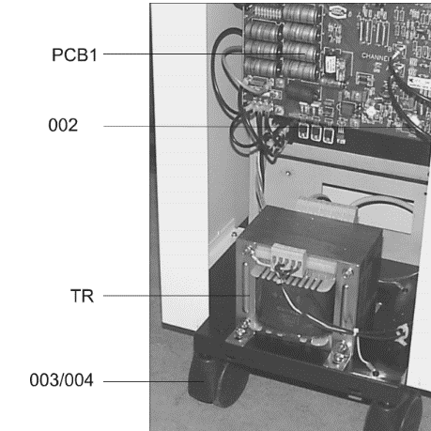
System Diagram
Enraf Nonius Curapulse 670
©
Short-wave diathermy machine
dr. Chris R. Mol, BME, NORTEC, 2015

Slide 13
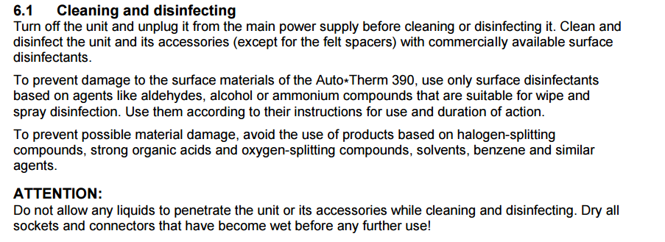
Maintenance
©
Short-wave diathermy machine
dr. Chris R. Mol, BME, NORTEC, 2015

Slide 14
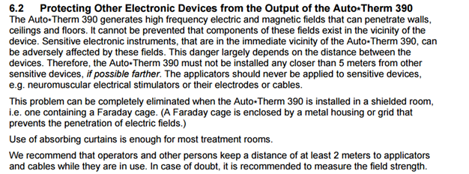
EM Radiation
©
Short-wave diathermy machine
dr. Chris R. Mol, BME, NORTEC, 2015

Slide 15
Preventive Maintenance
©
Short-wave diathermy machine
dr. Chris R. Mol, BME, NORTEC, 2015

Slide 16
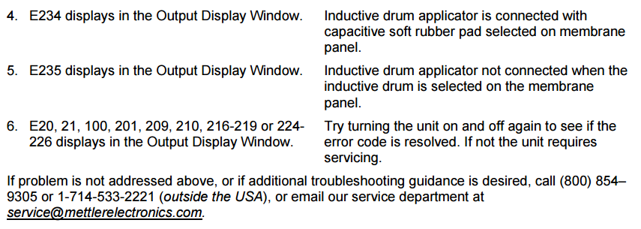
©
Short-wave diathermy machine
dr. Chris R. Mol, BME, NORTEC, 2015

Slide 17
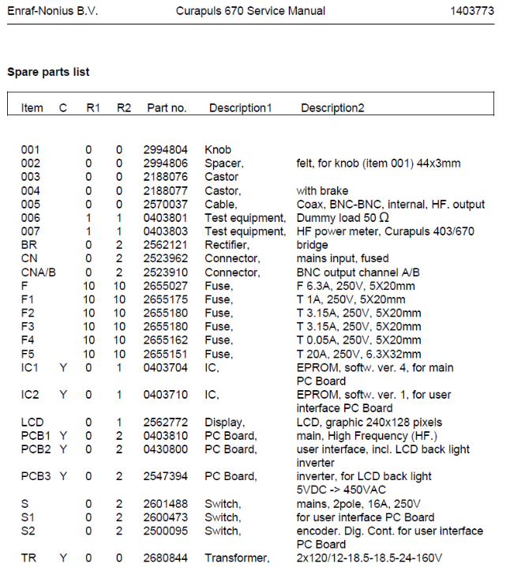
Spare Parts
Example of Spare Parts list
Fuses, knobs, castors, cables, switches, transformer can possibly be found locally
IC and PC Boards and (probably) display need to come from the manufacturer
©
Short-wave diathermy machine
dr. Chris R. Mol, BME, NORTEC, 2015

Slide 18
Safety Considerations
Dangers of Short Wave Diathermy
Burns.
Faintness due to lowered blood pressure
Sparking if one electrodes touched during the application of the current
Electric shock. During diathermy treatment, the patient becomes a part of the electrical field. Touching a bare metal object, such as a cabinet, during diathermy can cause a shock or burn.
Overdose will cause severe pain.
Contra Indications (situations in which the procedure should not be used)
Patients with implanted metal devices, such as a pacemaker, a prosthesis, or an intrauterine device. The electromagnetic energy used in diathermy can cause extreme heat in metal devices such as bone pins, dental fillings, and metal sutures. This could cause burns in adjacent tissues.
Patients with impaired thermal sensation
Do not apply over pregnant uterus
This unit works with significant power and high voltage. It is not battery operated.
©
Short-wave diathermy machine
dr. Chris R. Mol, BME, NORTEC, 2015

Slide 19
END
The creation of this presentation was supported by a grant from THET:
see https://www.thet.org/

